Slide 1

Take a Picture:
Connecticut State Grange presents
Photography Tips & Tricks
for Granges
Connecticut State Grange Virtual Social Hour

Slide 2


Slide 3
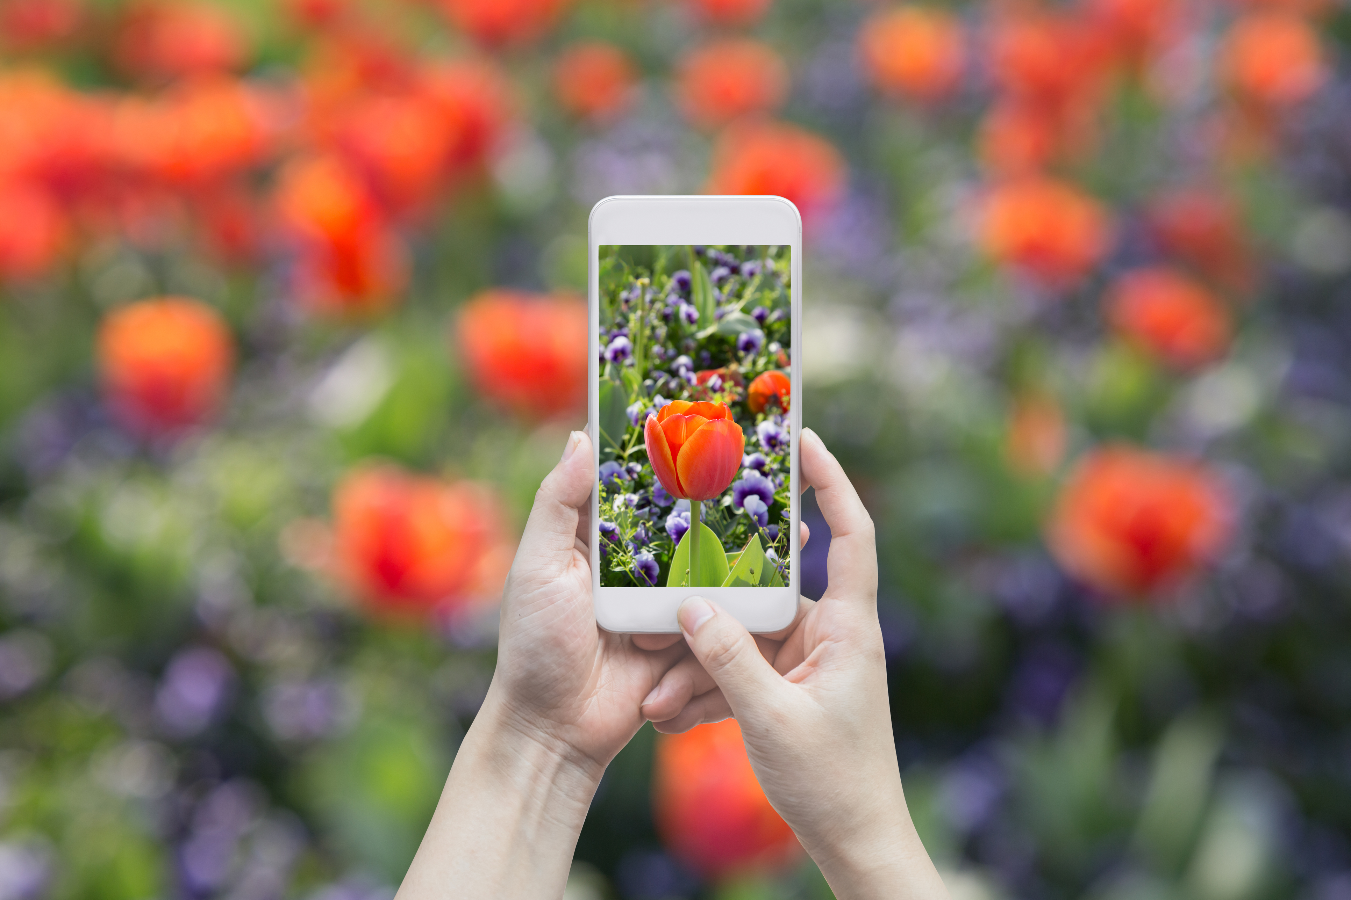
Grange's have limited budgets,
so hiring a photographer to
document your events and
meetings is out of the question.
Yet there are numerous people
who are currently attending your meetings and events who
already have photo capabilities
right in their hands.

Slide 4
Tips for capturing
great Grange photos

Slide 5

Plan ahead. Whether you are taking photos
of an event or the day-to-day happenings
at your next meeting, it’s always important
to be prepared.
Be sure to think ahead and ask yourself
a few key questions.
What photos do you absolutely have to take?
What moments do you want to capture?

Slide 6

Take more photos than
you think you will need.
You’ve planned ahead and know which photos to take, but don’t stop there! Take a lot more, even if you’re not sure when or how you’ll use them. Take generic photos too.
Take photos of random Grange things around your hall -
such as sashes, staves, the Grange rug, the flag, officer stations, the piano, etc. And don't forget to take photos of the outside of your building or
meeting location. You never know when a generic photo
you took a few months ago will make
a great addition to your
current postings.

Slide 7
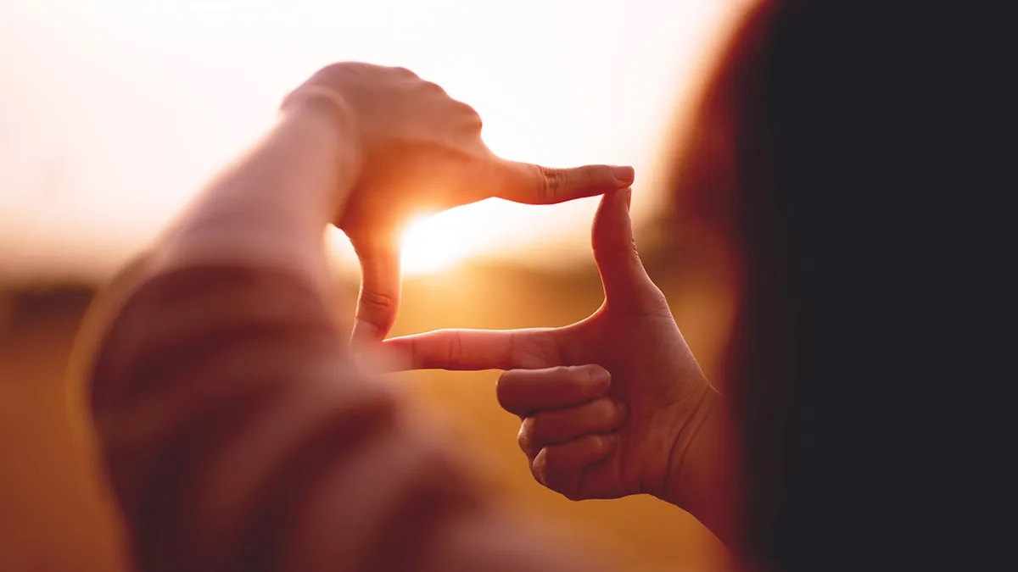
Keep framing your photo in mind.
What you are leaving out of a photo is just as important as what you are including.
Be sure you don’t include something in the background
that you don’t want, like an errant trashcan or a strange sign.
If you are taking a portrait, for instance, don’t frame the person
in a funny way, like leaving off a waving hand
or cropping them
right at the knees.

Slide 8
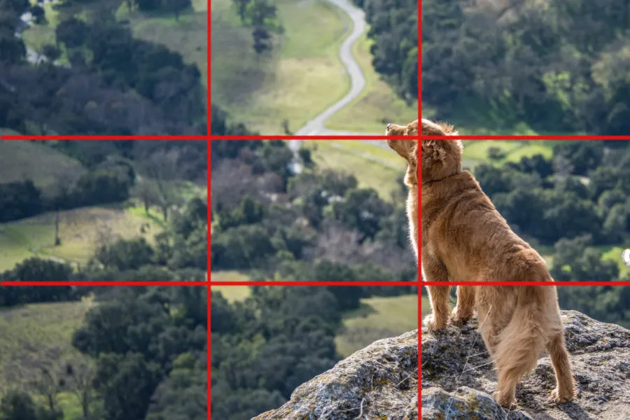
Rule of Thirds.
Because the human eye tends to be more drawn to images divided into thirds, place the main subjects of your image along these divisions or their intersections.
Before you crop or edit your photo, visualize the frame as a tic-tac-toe grid with two vertical and two horizontal lines, dividing the image into
nine equal parts. Rather than simply centering your
main subject, increase visual interest
by placing it at an intersection point
or along the one of the lines.

Slide 9


Slide 10
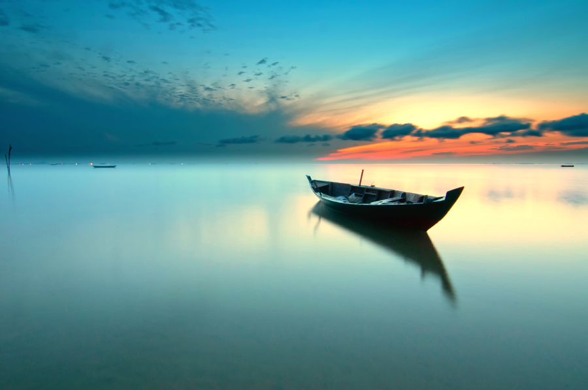
Leave space around your subject.
The empty space in your image can be just as important as your main subject. The term “white space,” also known as negative or blank space, refers to the space between or surrounding your main subjects in a photo.
It’s a key element of good design and photography,
as it defines and emphasizes the main subjects in your composition.
It draws the eye right to your subject, and it also
prevents your photo from
appearing too crowded.

Slide 11
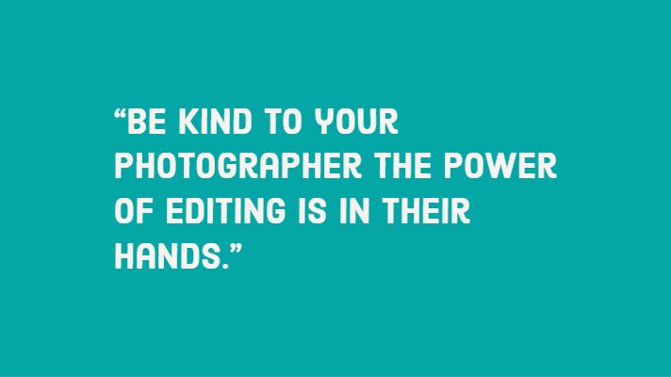

Slide 12
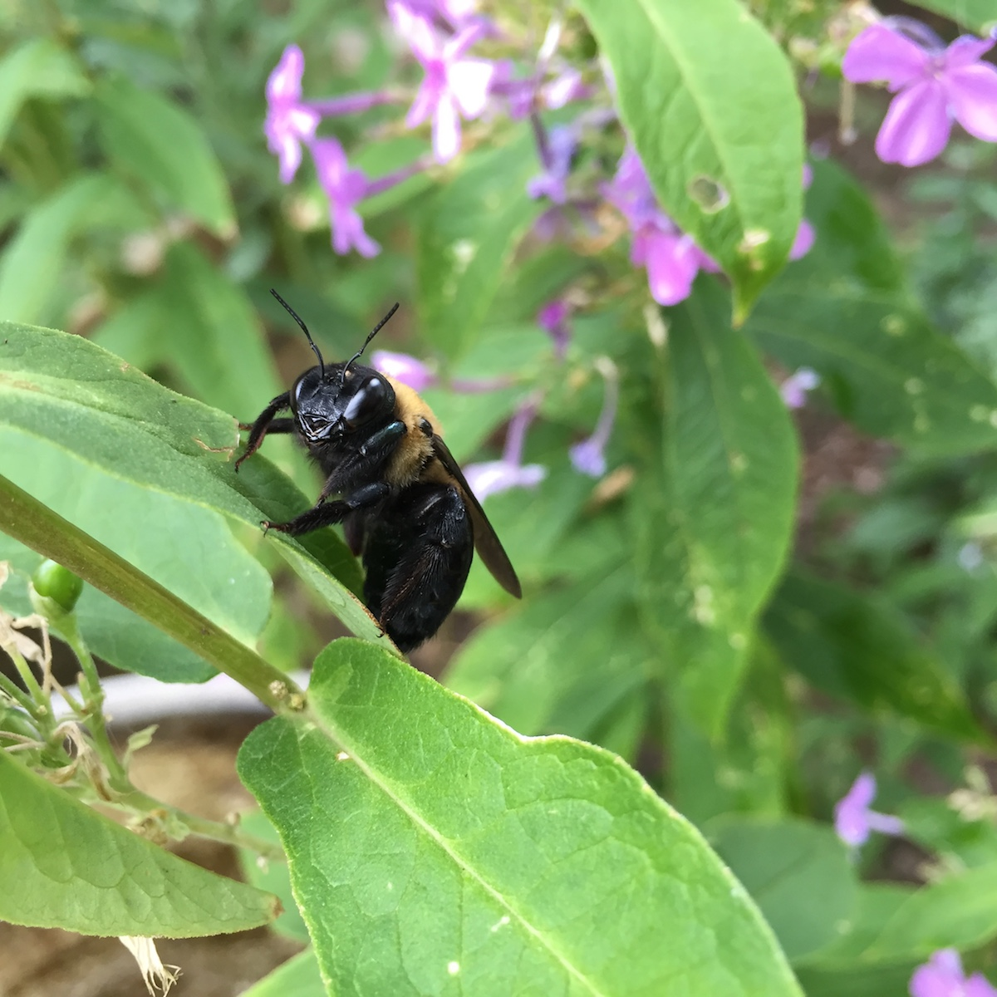
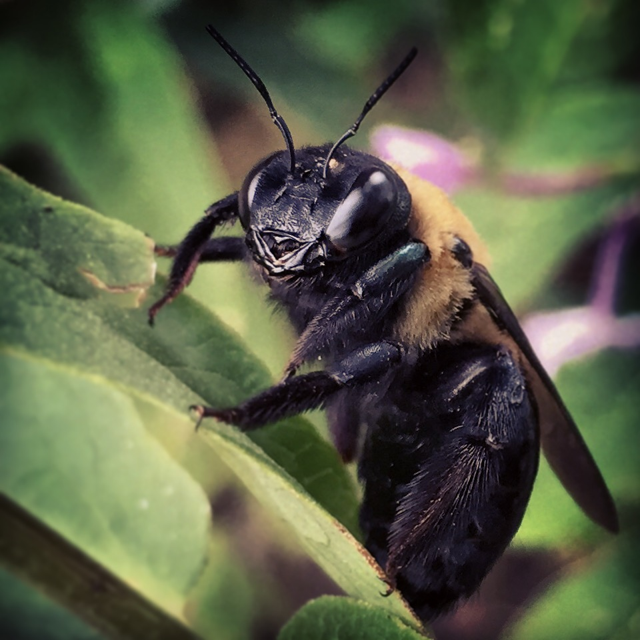
Editing Your Photo.
Edit your photos before publishing. The latest smartphones do a lot of the editing for you, but enhancing your photos a little bit can go a long way. Consider cropping, straightening, brightening, contrasting, and color correcting.
For example, you might crop out something in the background, straighten the angle of a building, brighten and contrast to add a little more interest, and change the hue (perhaps your photo is too yellow/warm, or too blue/cold).

Slide 13
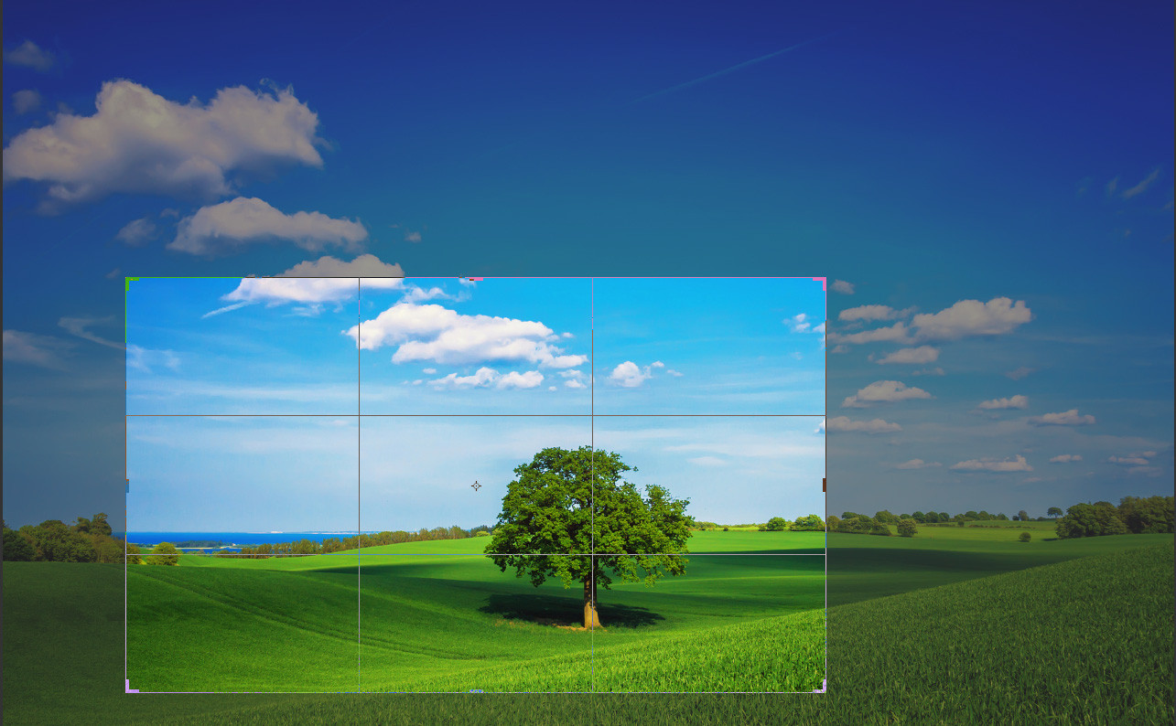
Cropping.
When cropping your photos, leave some space around your subject. Think of it as giving your subject some “breathing room.” In fact, don’t be afraid of leaving lots of background space in your photo.
Remember when taking your photo, that you can always crop the photo.
Space can give your viewer a sense of the environment
and context in which your photo was taken.
When used thoughtfully, it can create
a more dynamic composition that
evokes stronger emotions.

Slide 14

Get to know your subject.
If you are taking photos of a person,
such as a volunteer, Grange member,
or supporter, spend some time getting
to know them.
Small talk puts the subject of the photo at ease.
Think - ‘How can I make them smile?
How can I make them feel at ease?
How can I make them happy?’

Slide 15

Tell a story.
Don’t just take a picture of a member or a tree or the building. Be intentional. Show the member receiving the award, shaking hands with the Grange officer, and proudly showing off their new certificate.
Show a tree next to the Grange sign that indicates the years
of growth of the Grange. Show the Grange Hall that is being
renovated, but also highlight what that will look like for the
neighborhood as a whole. Tell a story. Think of all the
iconic pictures you have ever looked at
and I guarantee they have
a story within the image.

Slide 16
Remember to capture the details and emotions.
If you are taking photos of a person, consider what they are doing.
What is it you need to capture based on their actions?
For example, capturing the tear that is on the cheek
can make the perfect photo.
Ask yourself - Are they holding something in their hands?
Are they talking to somebody else? Are they behind a table?
Are they handing out something to someone else?
Try to get detail shots of what they are doing,
and then try snapping some photos from farther away.

Slide 17
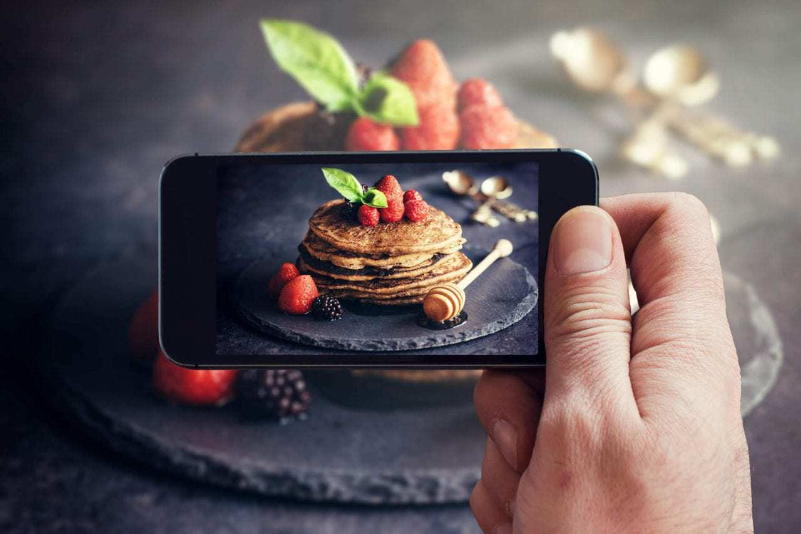
For example…
If you are taking pictures of a Grange member filling a bag with food, capture some photos of the member’s hands at work.
Then, back up and take a
photo of the entirety of what they are doing.

Slide 18
Find natural light whenever possible.
Natural light is ideal. You want to try and minimize the yellow or the
blue light casts that you're going to get when taking photos inside.
Avoid standing right in bright sunlight since it can cast shadows
and force people to squint.
Look for a shady area, perhaps under a tree or beside a building.
When inside, avoid taking photos directly in front of windows,
(this is called backlighting), to eliminate darkness and shadows.

Slide 19
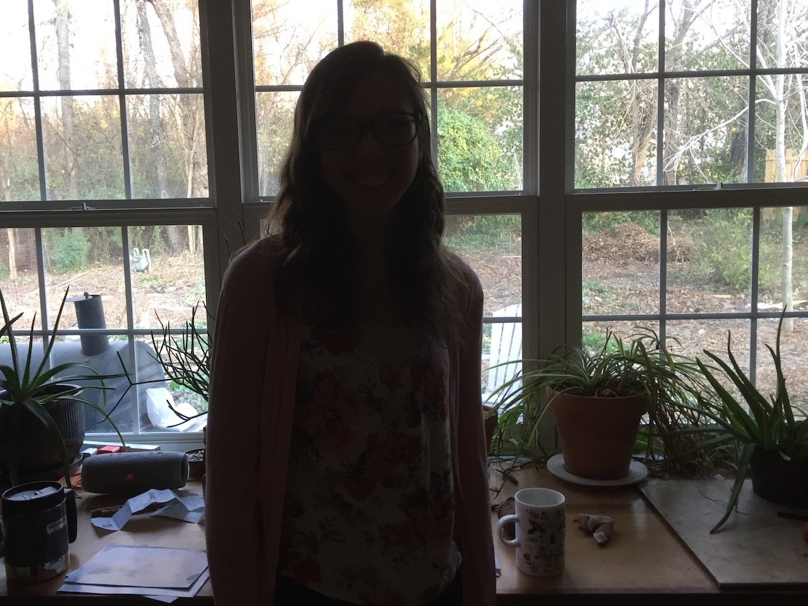
More on Natural Lighting.
Unless you’re going for something artsy
like a silhouette, you should generally
never take a photo of people with their
backs to the main light source.
This gets rid of so much of the detail in the faces that it’s
usually not even worth it to take the photo!
When in this situation, just have the subject turn
to face the light (as the photographer,
put your back to the light!).
It’s that simple.

Slide 20
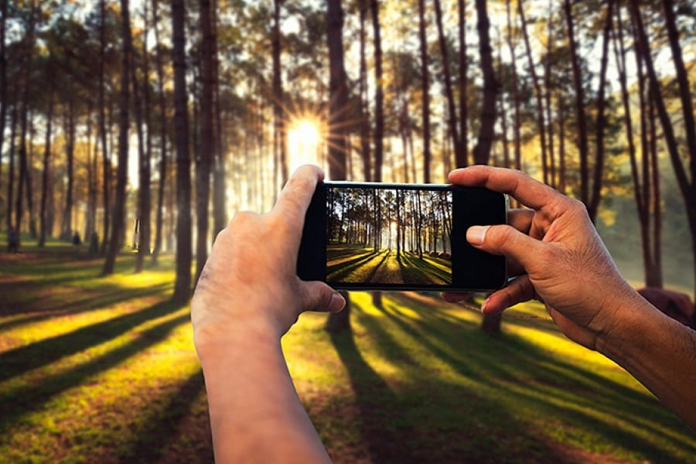
Another Lighting Tip.
If you are taking photos of an event and
the lighting isn’t good, ask your subject to take some quick photos after the event in a location that offers better lighting, like outside,
or near the building and sign.
For example, you might not necessarily need a picture of the person speaking at a podium under bright fluorescent lights, but having a great picture of that person somewhere in a better location could be valuable.
Unless there’s no other option for
light, you should usually avoid
using your phone’s flash.

Slide 21
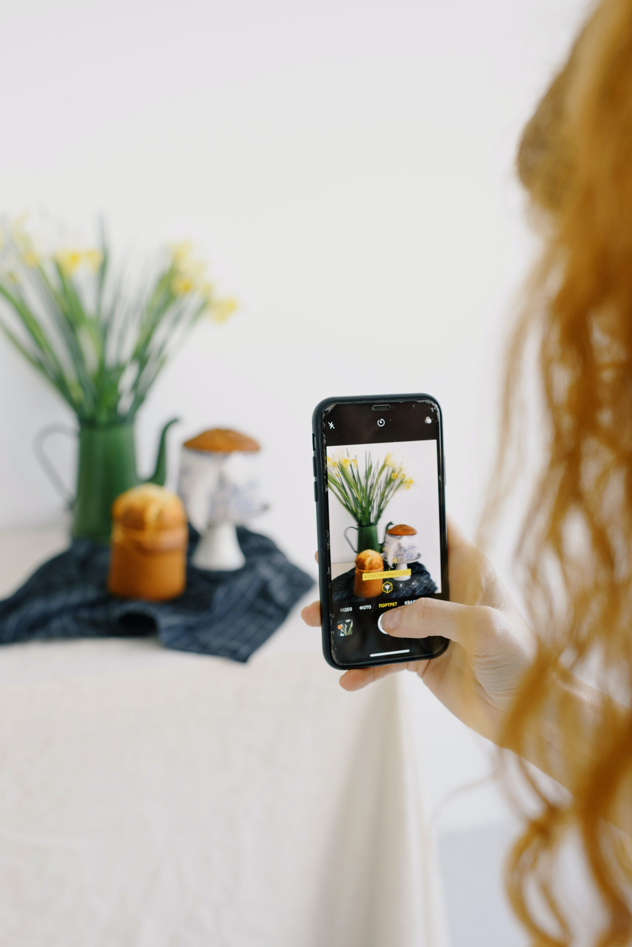
Get Creative.
Don’t be afraid to get creative, and have some fun too. Create innovative photo opportunities. Set-up a red carpet entrance for your Awards Night and take photos of your members as they enter. Take pet photos with Santa at Christmas. Set-up a photo booth at your Fair or Picnic. Have a collector's night and take photos of each member with their collection. The possibilities are endless.

Slide 22
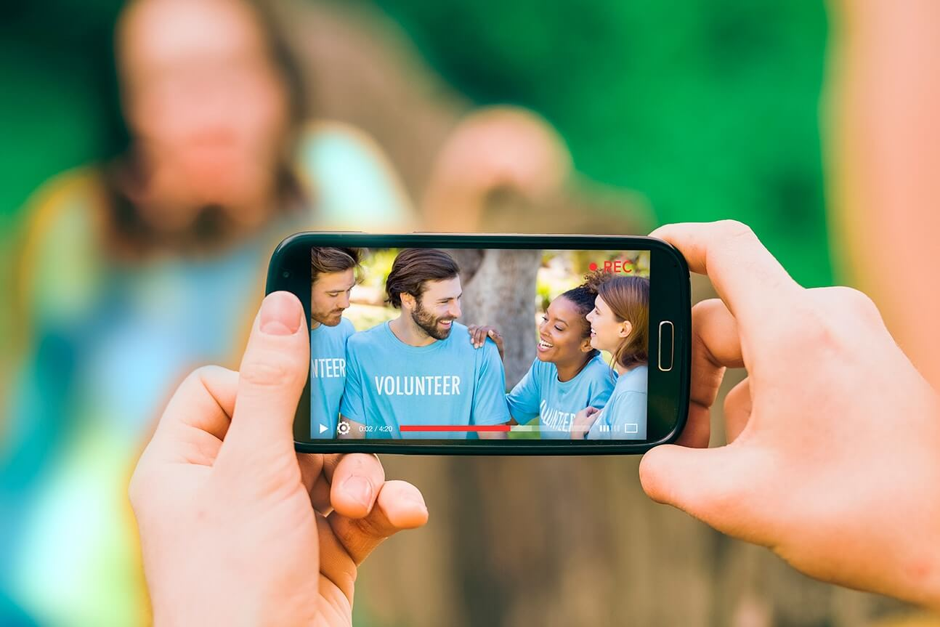
Do Something Unexpected.
Don’t feel limited to hard and fast photography rules; they are simply guidelines to help enhance your image. Investing more time and thought into your images can greatly influence someone’s perception of your Grange, its professionalism, and story.
Use quality, compelling photos on your Facebook, Instagram, other social media, and website that move potential supporters
and new members to action.

Slide 23
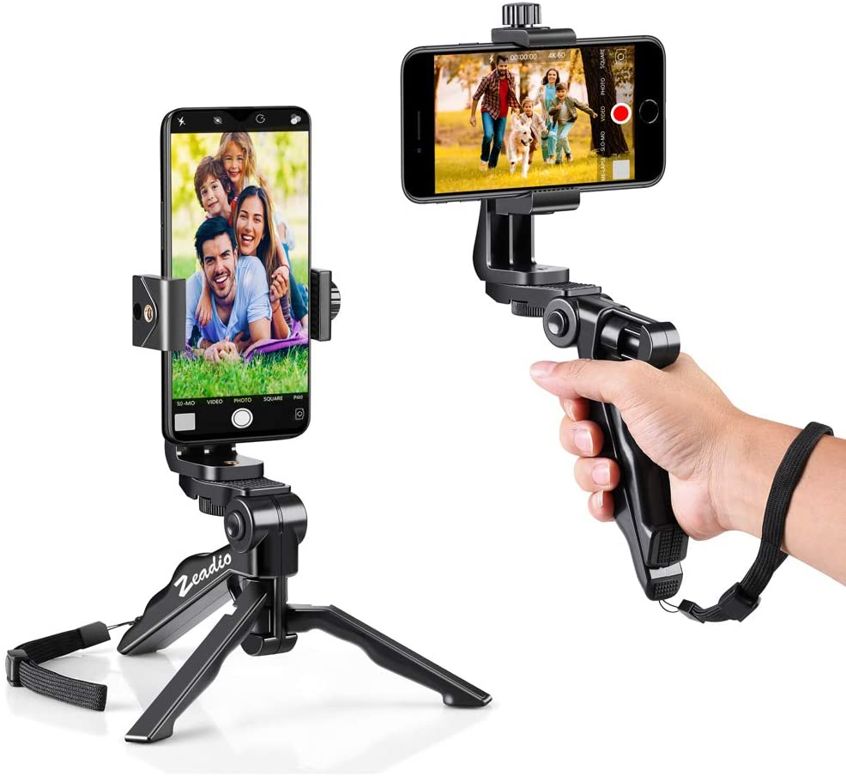
Be steady and think of the focus.
Shaky hands are just as bad for phone images (especially in low light) as they are for larger cameras.
When in doubt, take multiple photos
or even a burst. Try to rest your arm
on a surface for balance,
or use a tripod or monopod.

Slide 24
Ask permission.
Most people who attend events and functions expect a photographer
to be there, and understand that the photographer will be actively
taking photos. But, not everyone is comfortable in having their photos
taken and thus put out for the public to see. One way to assure that
this is ok is to have the person sign a photo consent form.
(Consent forms are available from the public relations committee.)
We realize that this is not always practical, so public rules and
photographer's constitutional rights often apply. But it is always
good to ask before photographing the subject.

Slide 25
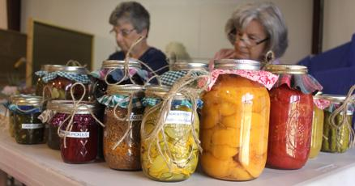
Public Spaces Rights.
When you host an event at your
Grange Hall that is open to the public,
then public spaces rights apply.
"It is generally permissible for people to take photographs at any public place or any private place that they own or rent. It is legal to photograph or videotape anything and anyone on any public property, within reasonable community standards. Photographing or videotaping a location or an attraction, when that location is opened to the public, whether publicly or privately owned, is considered legal."

Slide 26
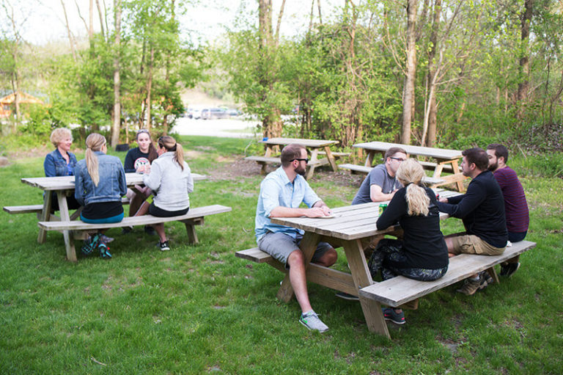
Public Spaces Rights.
More from the ACLU:
”When in public spaces where you are lawfully present you have the right to photograph/video anything that is in plain view. That includes pictures of federal buildings, transportation facilities, and police. Such photography is a form of public oversight over the government and is important in a free society."

Slide 27

Signage.
One action that Granges may want to consider is to
post a sign that is easily visible in the hall/location
that states the following:
"You could be famous! Cameras may be in use Outdoors and Indoors on these premises. Photography and Filming may be present. By entering you understand and consent that you may appear on camera and that the reproduction and use of your photograph, image, voice thereof, either in whole or in part, may be used by ____________ Grange, the Connecticut State Grange, and the National Grange for any and all advertising, trade or art purposes, without limitation
or reservation.
Thank you for your support."

Slide 28
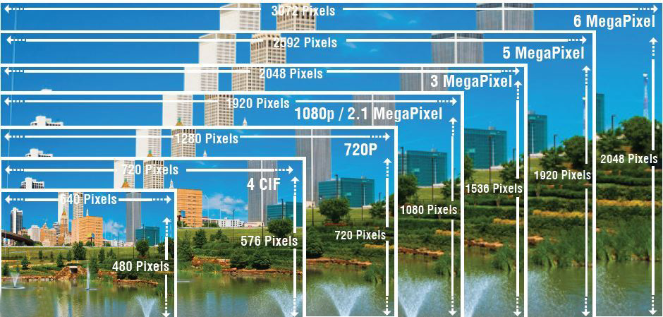
Prioritize good resolution.
Make sure to always use the largest photo size setting when posting online or texting or emailing photos to others. Images scale from large to small gracefully, but not necessarily from small to large.
And only put 2 or 3 photos together at one time when transferring pictures
to other people via email or text to ensure delivery.
(Send a series of multiple
texts/emails when you have
a lot of photos to send.)

Slide 29
Experiment and Practice.
Whether you’re just starting out with photography or a phone photo expert, practice and experiment to get
better and become more comfortable
with the photo process.
The more you actually get out there and start taking photos of things
that interest you, your Grange events, and your members too, the more experience you’ll gain. Have fun and enjoy the process
while learning more about what
makes a good photo.

Slide 30
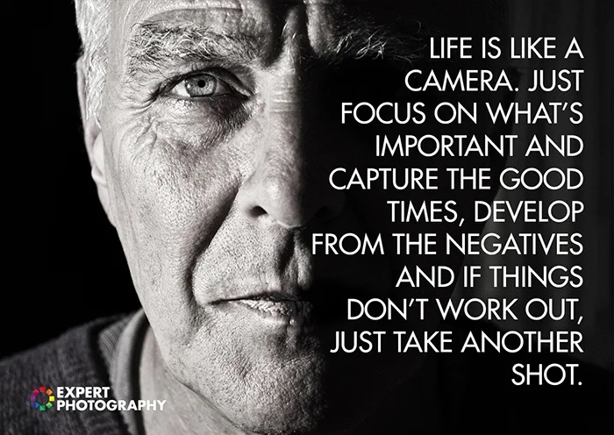

Slide 31
Connecticut State Grange Virtual Social Hour
May, 2022
@2022 Connecticut State Grange

